Slide 1
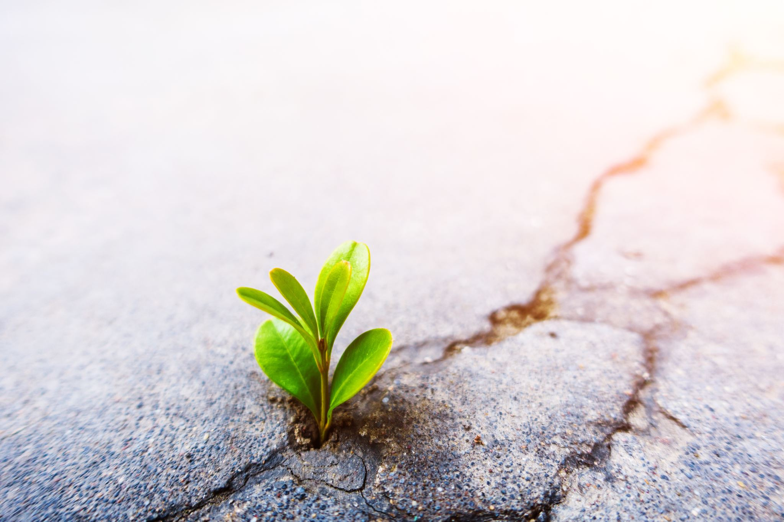
Resilience
First responders are human
Kerry C.

Slide 2
“Although the world is full of suffering, it is also full of overcoming it.”
- Helen Keller

Slide 3
What is Resilience?
An ability to recover from or adjust easily to misfortune or change.
Merriam-Webster

Slide 6
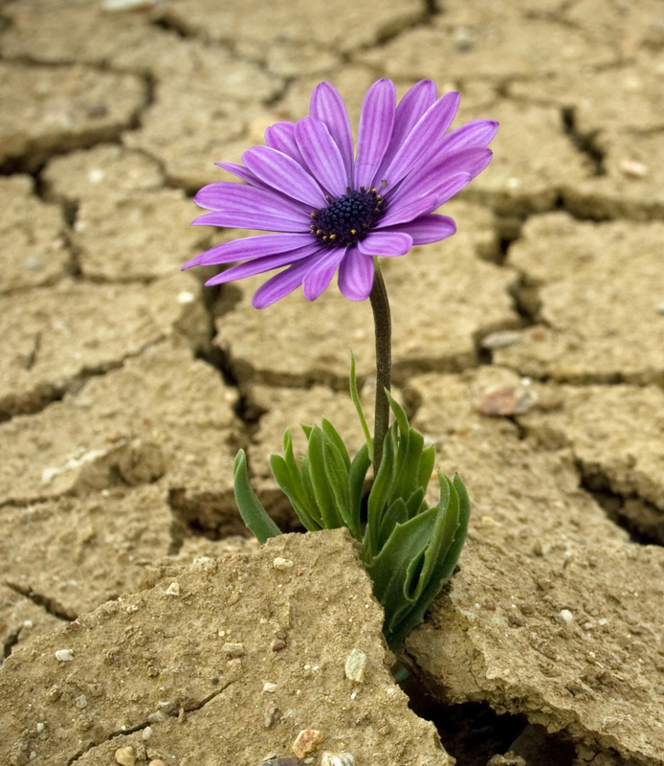
Increase your Resilience
Take care of your health and body
Engage in positive relationships
Make a list of hobbies and activities that make you happy
Make a playlist of songs that make you happy – Get up and dance!

Slide 7
Ways to Regulate Negative Emotions
- Give yourself permission to
experience and share your emotions
-Learn how to use mindfulness and mediation
Headspace and Calm Apps

Slide 8
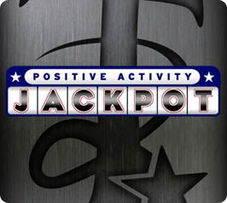
Building your Resilience website by the American Psychological Association
Meditation for Fidgety Skeptics by Dan Harris
Try it on audible
Apps featured above: Headspace, ROMWOD, Calm and Positive Activity Jackpot

